Slide 1
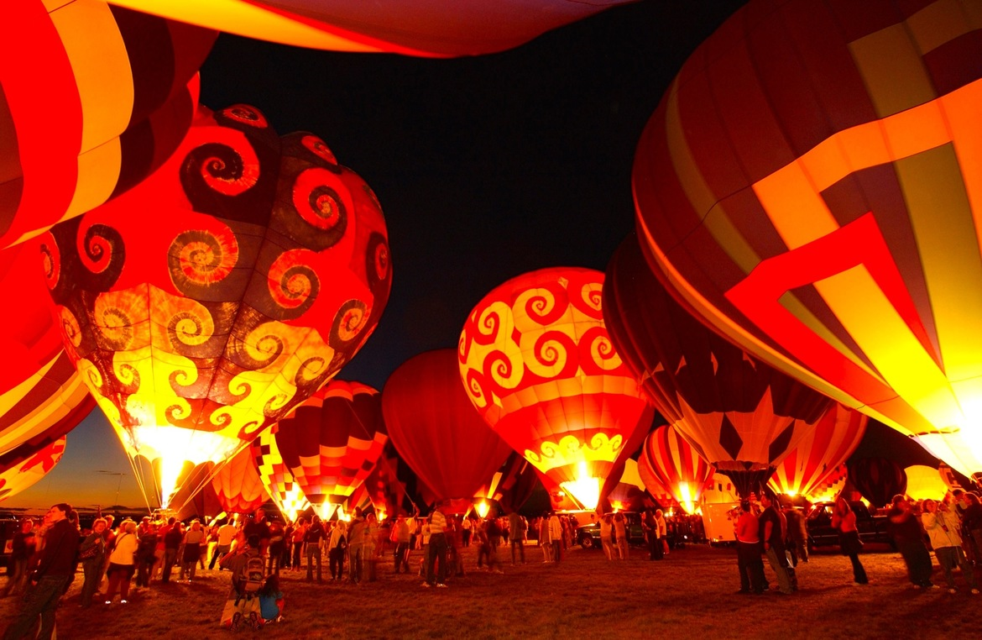
MONITOR CLASS
6 B
FESTIVALS AROUND THE WORLD

Slide 2

HOME ASSIGNMENT
Any Questions?
P. 119 ex. 1 write

Slide 3


Slide 4
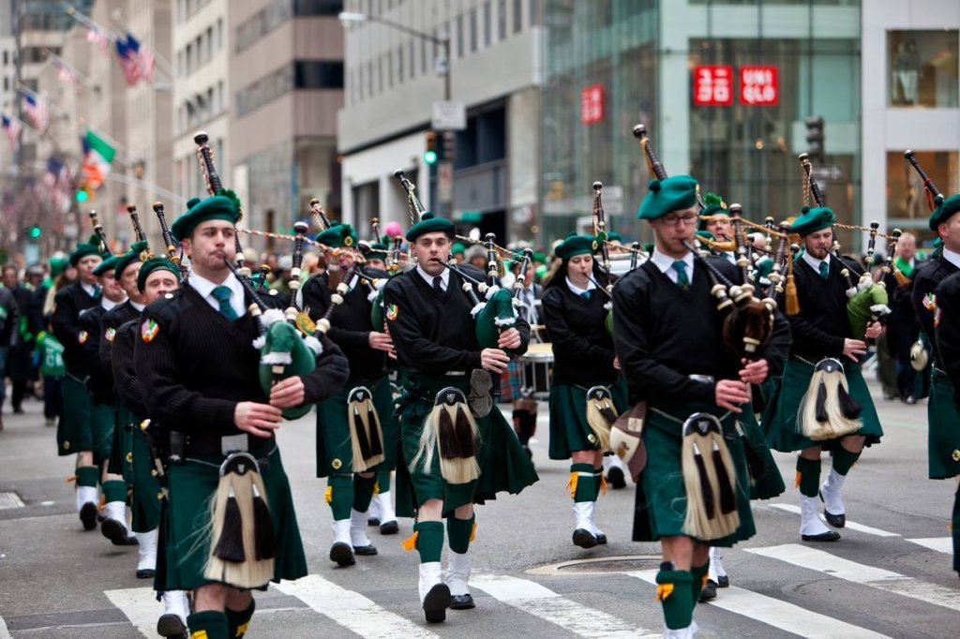
WINDOW ON THE WORLD
P. 116

Slide 5
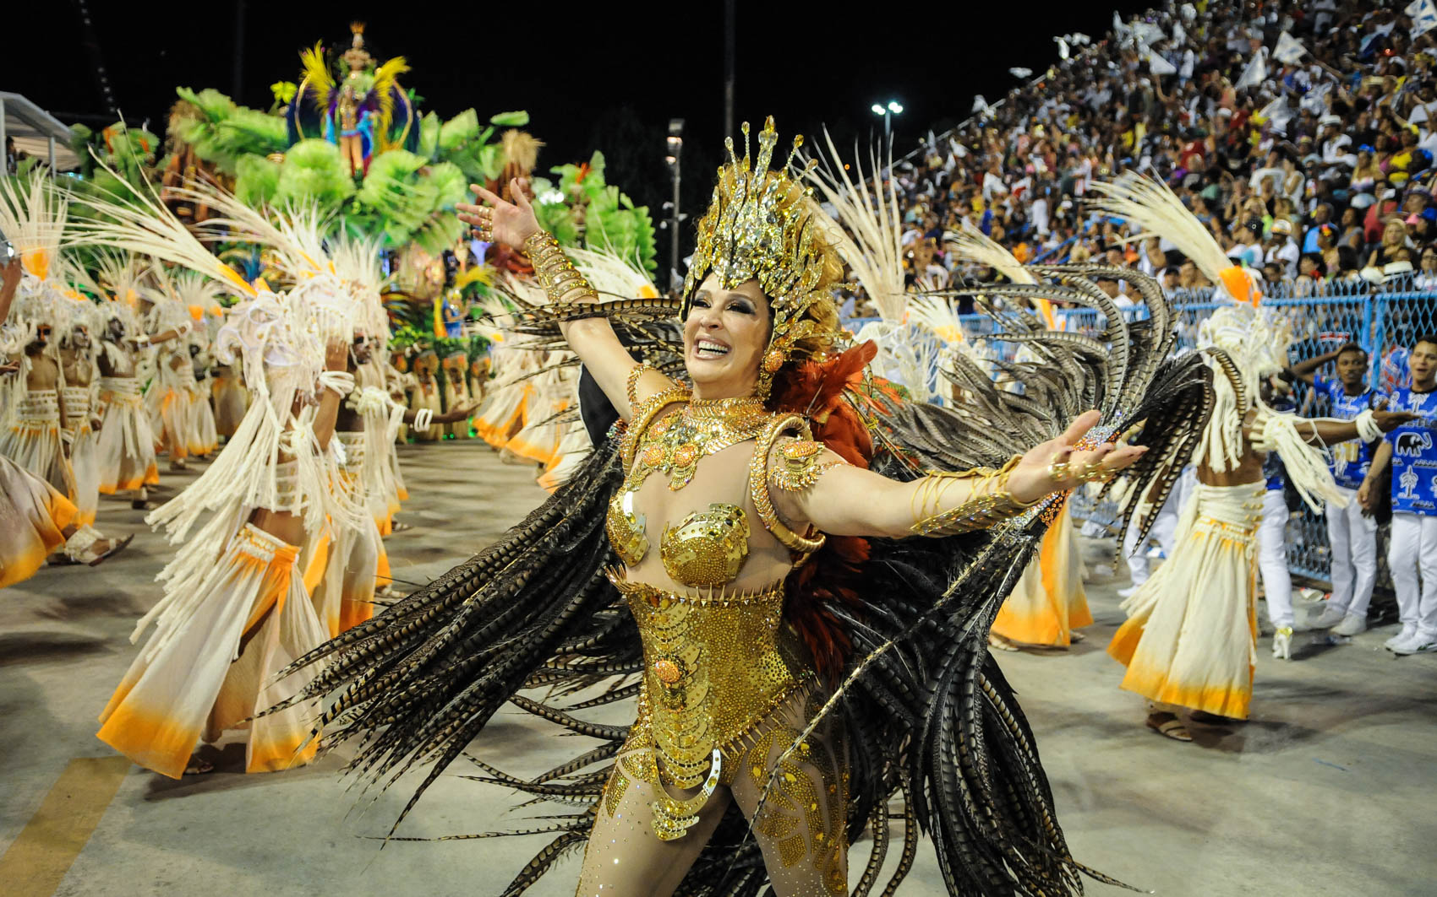
WINDOW ON THE WORLD p.116

Slide 6
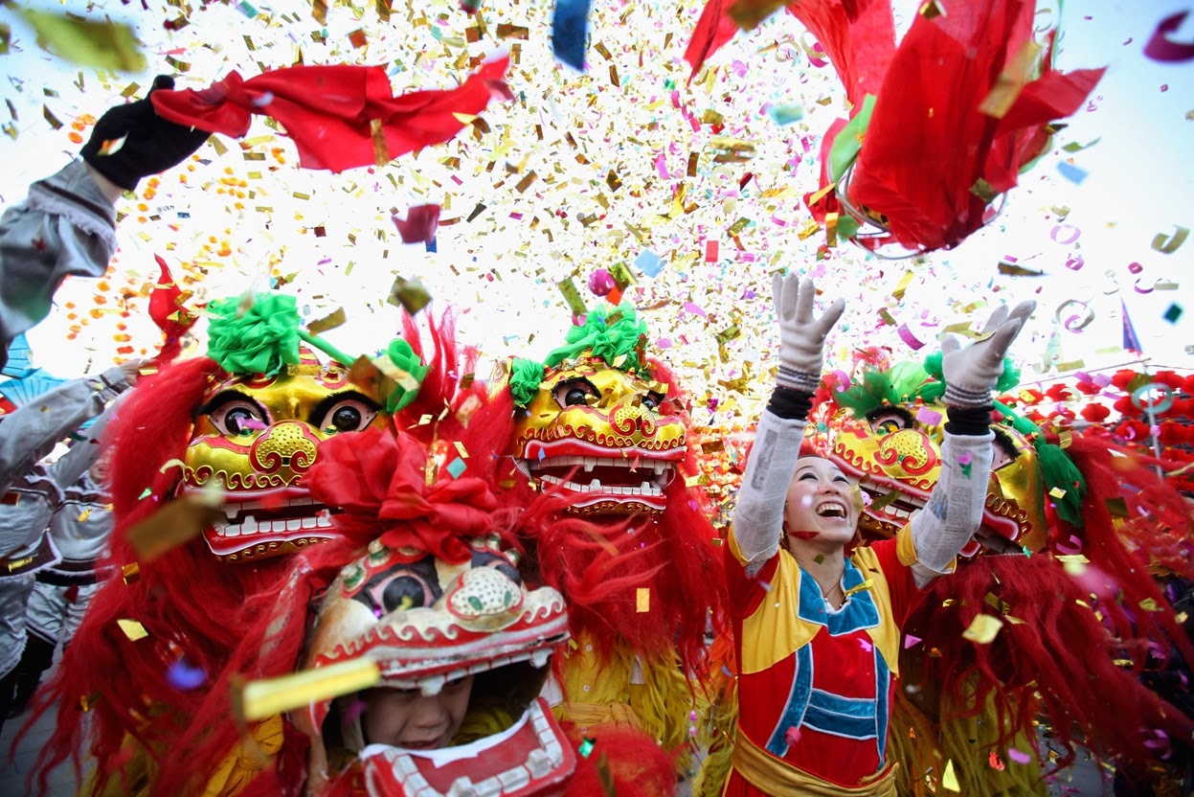
WINDOW ON THE WORLD p.116

Slide 7
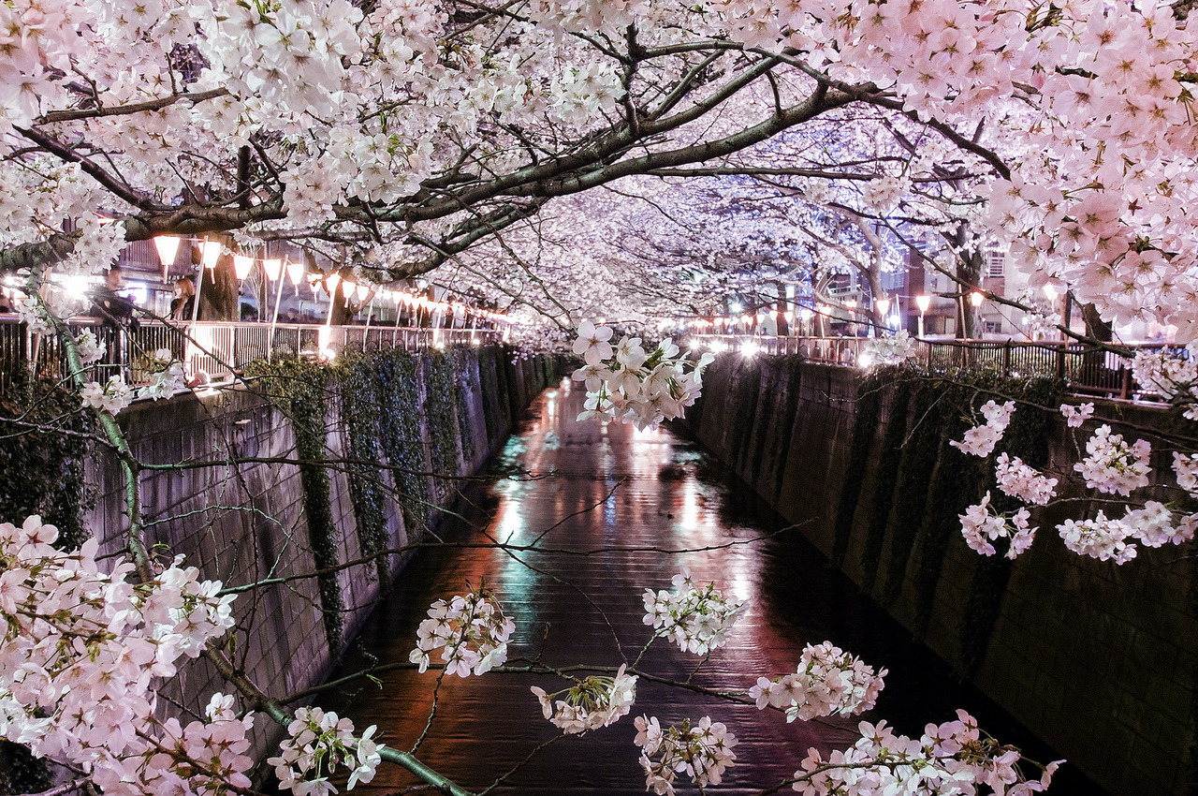
WINDOW ON THE WORLD p.116

Slide 8
WINDOW ON THE WORLD p.116 a)
SELF-CHECK
The Carnival in Brazil
Full-moon Day in Thailand
International Women’s Day in Russia
Full-moon Day in Thailand
St Patrick’s Day in Ireland
The Carnival in Brazil

Slide 9
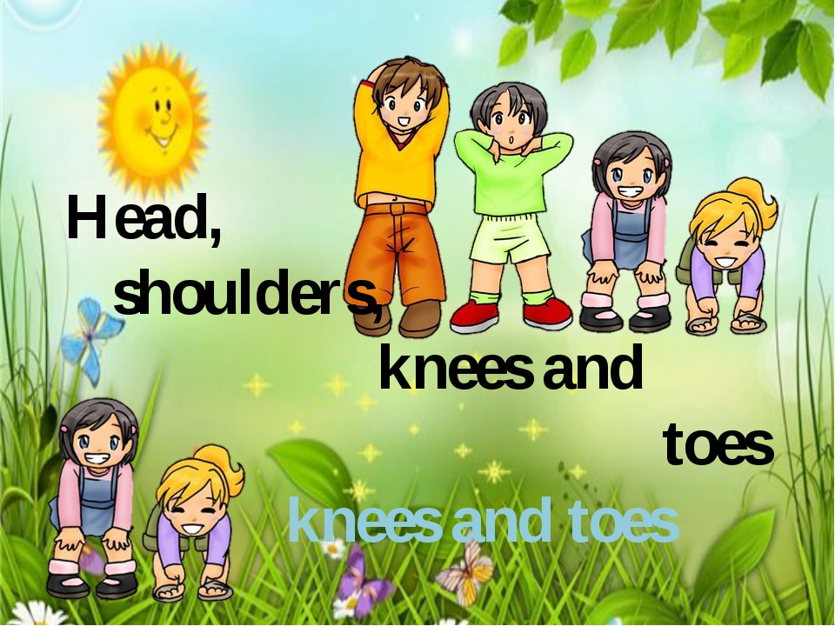
Time to Move!
https://youtu.be/WX8HmogNyCY?t=7

Slide 10
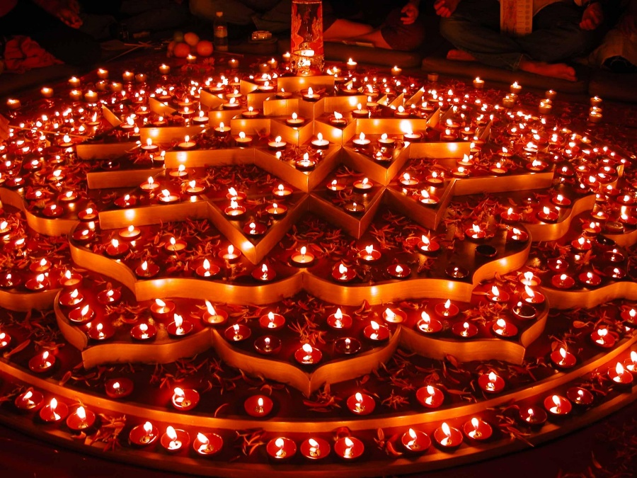
WINDOW ON THE WORLD
DIWALI https://learnenglishkids.britishcouncil.org/short-stories/my-favourite-day-diwali

Slide 11
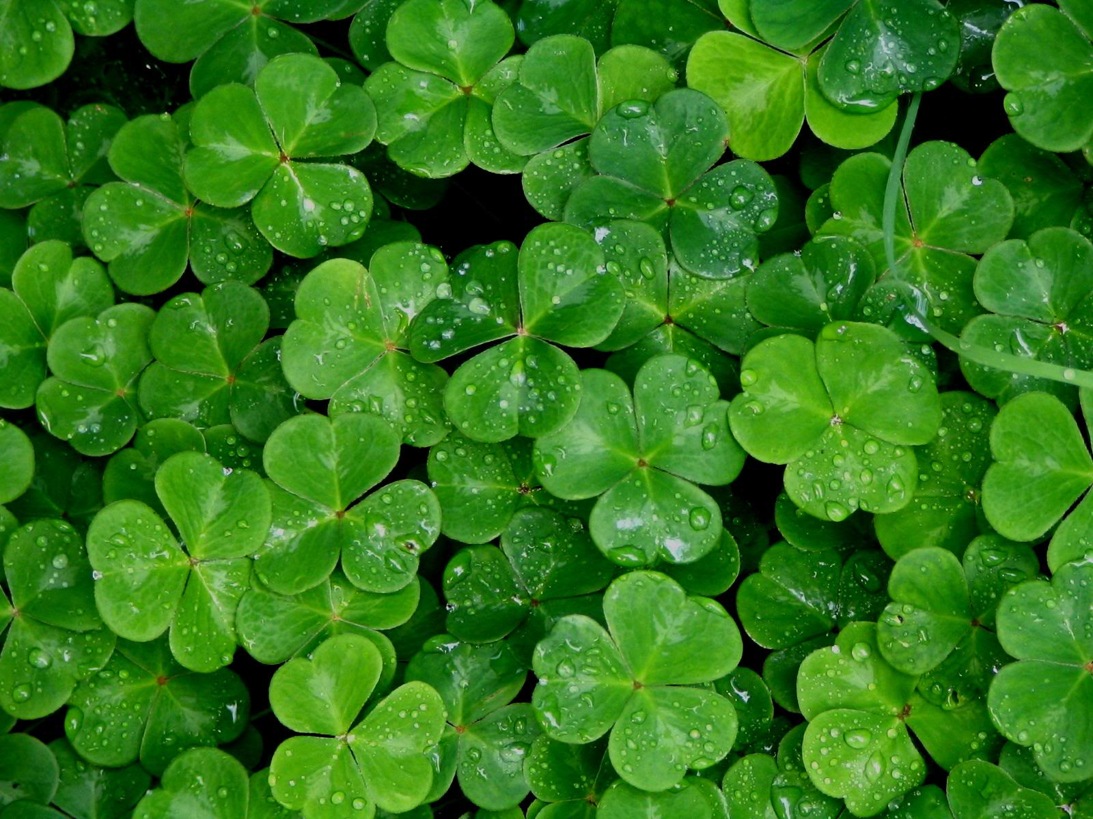
SUMMARY
SHAMROCK

Slide 12

CHERRY BLOSSOM

Slide 13
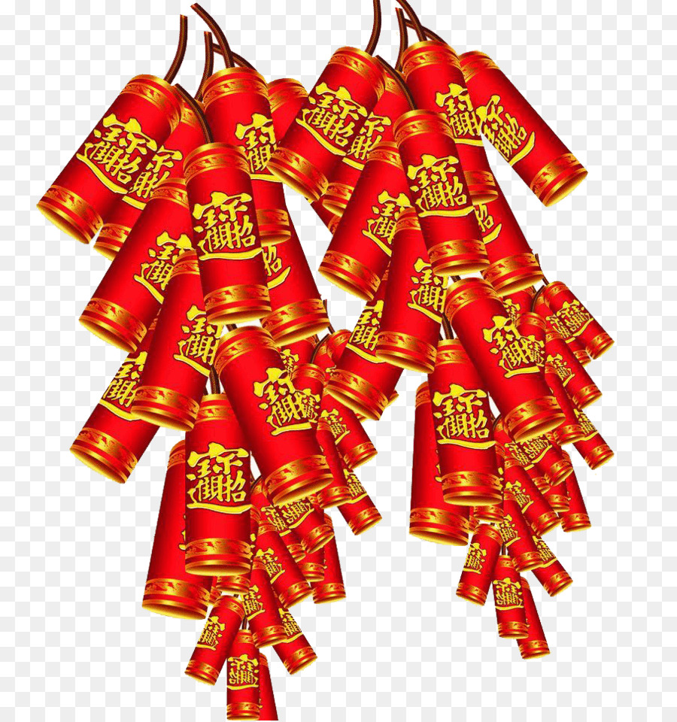
FIRECRACKERS

Slide 14
HOME ASSIGNMENT
P. 116 ex. B) –write about and draw your favourite festival

Slide 15

REFLECTION

